Slide 1
Feature Extraction and Price Prediction for Mobile Phones
Submitted By:
Name: Satish Vonteddu
Data Analytics Internship
NextHikes IT Solutions
L-110226-W2PM-B15

Slide 2
Project Objective: To identify the key features affecting mobile phone prices and build a machine learning model that accurately predicts mobile phone prices.
Business Problem
The mobile phone market is highly competitive, and pricing decisions depend on multiple specifications such as:
RAM
Memory
Processor
Camera
Battery
The organization wants to:
✅ Understand which features affect mobile prices.
✅ Predict the price of new mobile phones accurate

Slide 3
Project Objectives
Perform Feature Extraction.
Identify important features affecting price.
Build predictive machine learning models.
Compare different algorithms.
Recommend the best pricing strategy.

Slide 4
Dataset Description
Particular | Value
Total Records | 541
After Removing Duplicates | 531
Total Features | 11
Target Variable | Price
Features Used
Model
Colour
Memory
RAM
Battery Capacity
Rear Camera
Front Camera
AI Lens
Mobile Height
Processor
Price
Categorical Features
Model
Colour
Processor

Slide 5
Data Cleaning & Preprocessing
Data Cleaning Steps :
Removed unnecessary column
Removed duplicate rows.
Converted camera columns
No missing values were found.
Encoding : Applied
One Hot Encoding for: Model , Colour ,Processor
Final Dataset :
Rows = 531 Columns after Encoding = 590

Slide 6
Exploratory Data Analysis (EDA)
Univariate Analysis is Performed
Price Distribution
RAM Distribution
Memory Distribution
Processor Distribution
Key Findings
RAM: Most phones have 4 GB ,6 GB 8 GB RAM
Memory :Most phones have 64 GB ,128 GB ,256 GB Memory.

Slide 7
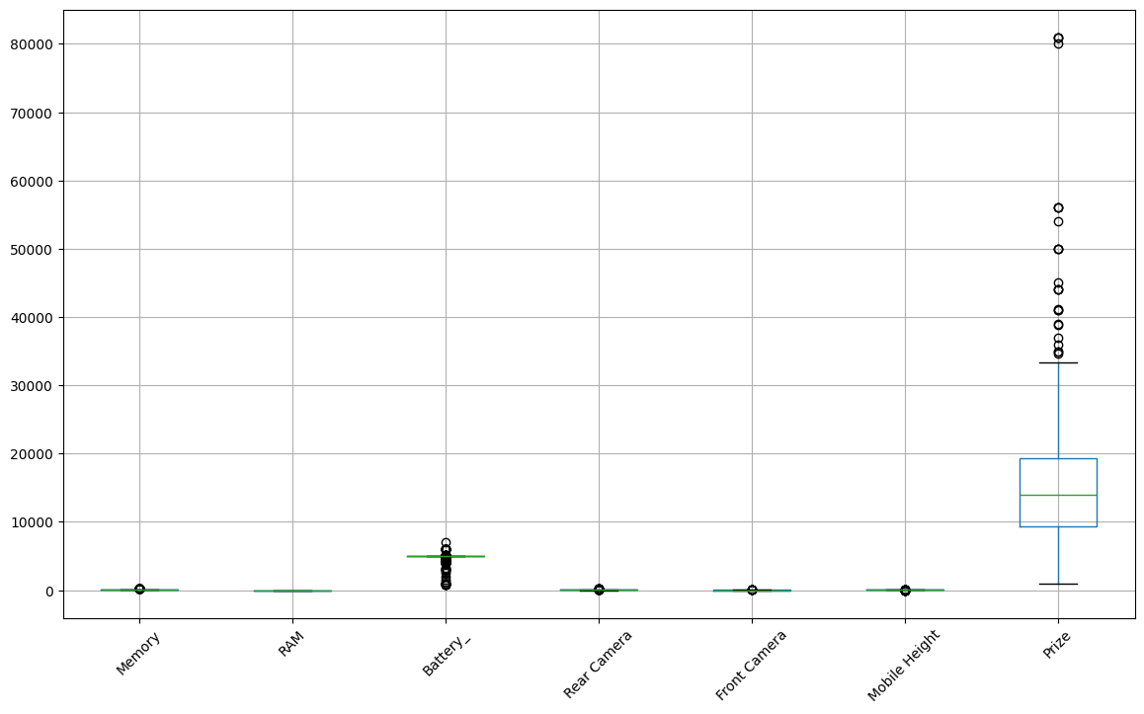
Price Distribution
Memory | RAM | Battery_ | Rear Camera | Front Camera | AI Lens | Mobile Height | Price
count | 531.000000 | 531.000000 | 531.000000 | 531.000000 | 531.000000 | 531.000000 | 531.000000 | 531.000000
mean | 110.915254 | 5.401130 | 4873.877589 | 46.227872 | 12.045198 | 0.064030 | 16.450019 | 16305.775895
std | 60.872883 | 1.991283 | 765.883129 | 31.392146 | 9.105142 | 0.245037 | 2.494246 | 10847.038354
min | 16.000000 | 2.000000 | 800.000000 | 0.000000 | 0.000000 | 0.000000 | 4.500000 | 920.000000
25% | 64.000000 | 4.000000 | 5000.000000 | 13.000000 | 5.000000 | 0.000000 | 16.510000 | 9368.000000
50% | 128.000000 | 6.000000 | 5000.000000 | 50.000000 | 8.000000 | 0.000000 | 16.710000 | 13999.000000
75% | 128.000000 | 8.000000 | 5000.000000 | 50.000000 | 16.000000 | 0.000000 | 16.940000 | 19338.500000
max | 256.000000 | 8.000000 | 7000.000000 | 200.000000 | 60.000000 | 1.000000 | 41.940000 | 80999.000000
Right-skewed distribution.
Premium phones act as outliers
.

Slide 8
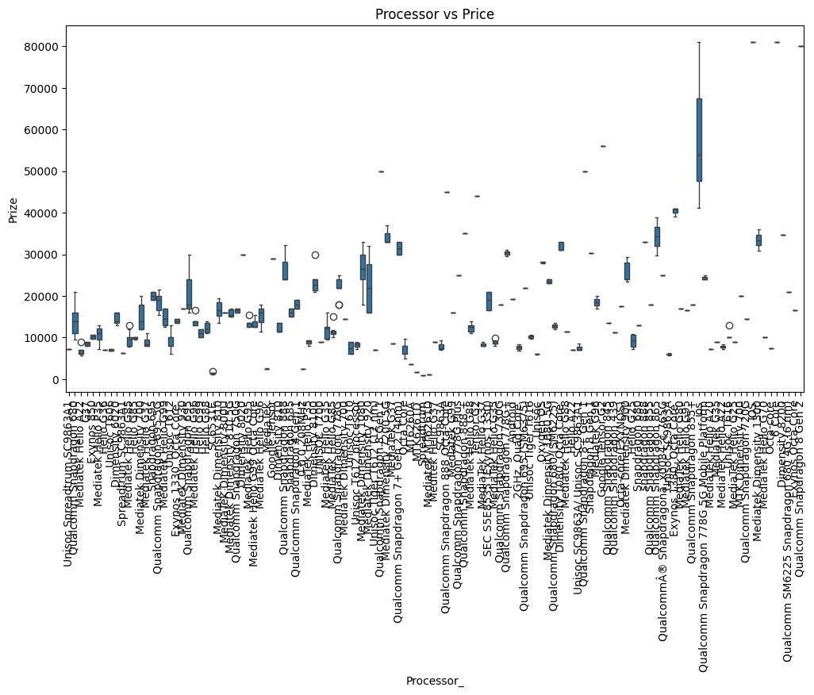
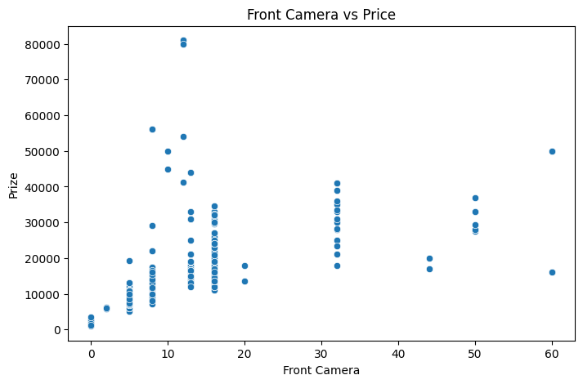
Bivariate & Multivariate Analysis
Strongest relationship with price:
Processor vs Price (clear separation of price ranges by processor type).
Secondary strong predictor: RAM vs Price.
Weakest relationship with price:
Front Camera vs Price (scatter shows little predictive power).
Battery also shows weak influence compared to RAM/Processor.
Feature | Correlation
Memory | 0.563
RAM | 0.529
Front Camera | 0.529
Rear Camera | 0.407
Mobile Height | 0.168
Battery | -0.046
AI Lens | -0.156

Slide 9
Machine Learning Models
Models Developed
Linear Regression
Decision Tree Regressor
Random Forest Regressor
XGBoost Regressor
Train Test Split : Training Data = 424 Rows and Testing Data = 107 Rows
Evaluation Metrics : MAE ,RMSE ,R² Score

Slide 10
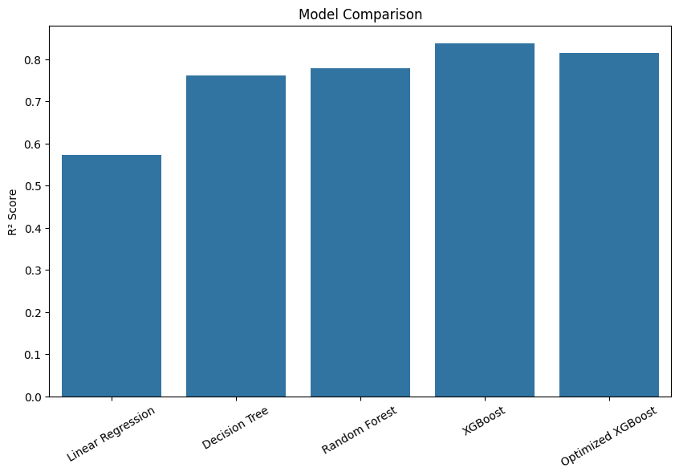
Model Performance Comparison
Model | MAE | RMSE | R²
Linear Regression | 2559.52 | 6714.24 | 0.572
Decision Tree | 1614.48 | 5017.55 | 0.761
Random Forest | 2073.05 | 4829.45 | 0.779
XGBoost | ⭐1573.85 | ⭐4133.04 | ⭐0.838
Optimized XGBoost | 1860.93 | 4430.49 | 0.814

Slide 11
Hyperparameter Tuning & Feature Importance
GridSearchCV
Best Parameters :
Learning Rate = 0.1
Max Depth = 3
Estimators = 300
Subsample = 0.8
Best Cross validation score : 88.55%

Slide 12
Important Features
Top Important Features
Processor : Processor type strongly influences premium pricing
RAM : RAM significantly increases mobile price.
Memory : Memory is one of the strongest drivers of price.
Front Camera : Camera specifications contribute positively to price.
Battery : Battery capacity alone has little impact on pricing decisions.

Slide 13
Business Recommendations
Recommendation 1 : Focus on launching devices with higher RAM and Memory configurations because these features strongly influence price.
Recommendation 2 : Premium processors can justify higher pricing strategies.
Recommendation 3 : Camera specifications positively affect pricing and customer perception.
Recommendation 4 : Battery capacity alone should not be considered a premium pricing factor.
Recommendation 5 : Use the XGBoost model to estimate prices of upcoming mobile devices before launch.

Slide 14
Conclusion
Project Summary
✅ Performed Feature Extraction.
✅ Conducted EDA and Correlation Analysis.
✅ Built four machine learning models.
✅ Compared model performances.
✅ Identified key pricing drivers.
Final Conclusion : The XGBoost Regressor achieved the best performance:
MAE = 1573.85 RMSE = 4133.04 R² = 83.80%
The most influential factors affecting mobile prices are:
Processor ,RAM ,Memory ,Camera Specifications ,Battery
The developed model can help organizations make better pricing decisions and predict prices of new mobile devices.

